Slide 1
Installation Guide
(Eclipse Plug-in － AnyEdit 2.2.0 on Eclipse 3.5)
2009. 07. 28
CODELABOR
Shin Sang Jae (codelabor@gmail.com)

Slide 2
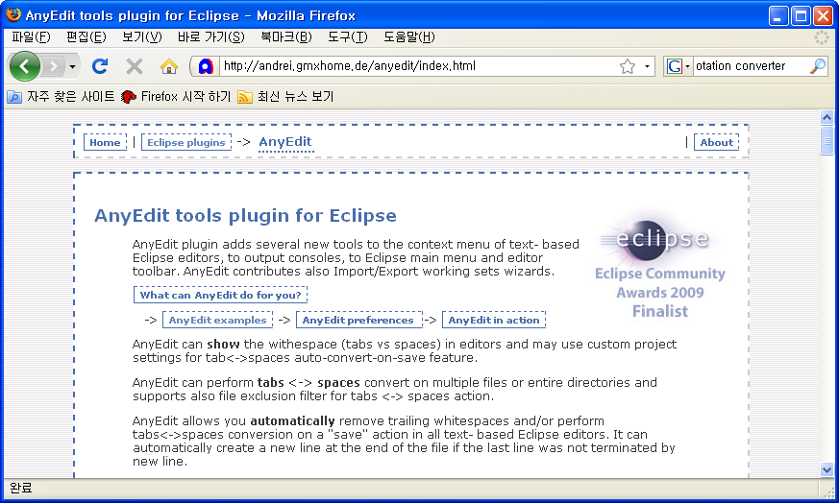
Subclipse
Site
Officical Site: http://andrei.gmxhome.de/anyedit/index.html

Slide 3
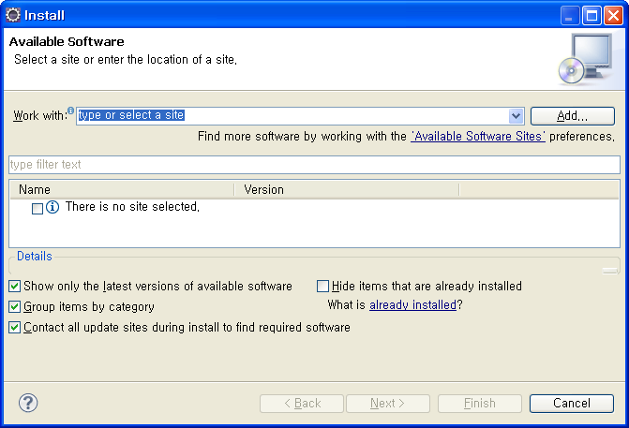
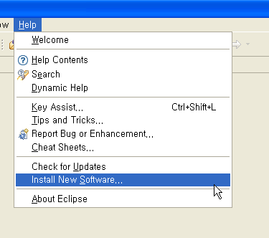
Subclipse
Install
Menu
  Help > Install New Software...
Install Window
  Work With: > Add

Slide 4
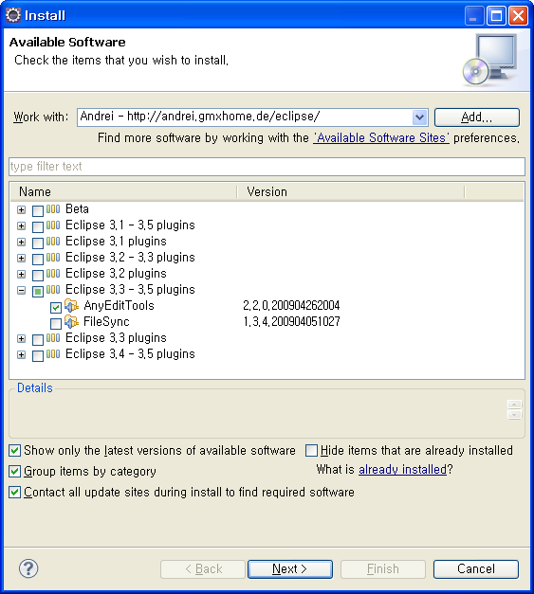
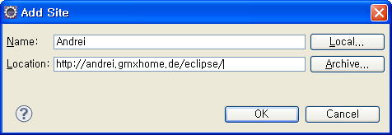
Subclipse
Add Site
Add Site Windows
  Name: Andrei
  Location: http://andrei.gmxhome.de/eclipse
  Check Eclipse 3.3 – 3.5 plugins > AnyEditTools

Slide 5
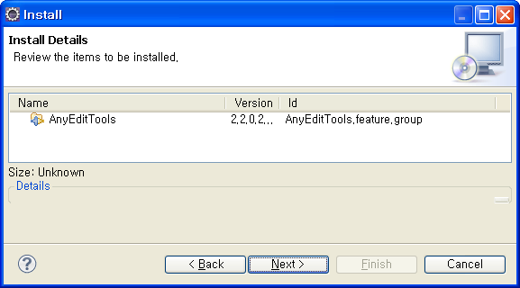
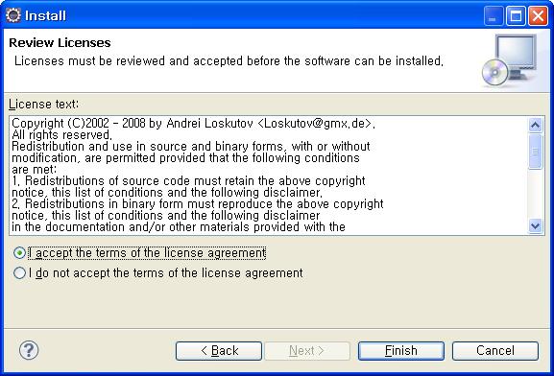
Subclipse
Install
Install Details Window
Accept the terms of the license agreements

Slide 6
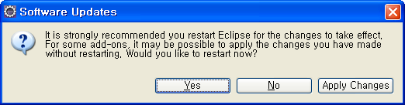
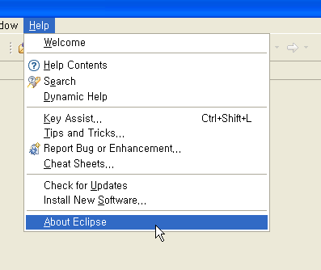
Subclipse
Software Updates
Software Updates Window
  Restart
Menu
  Help > About Eclipse

Slide 7
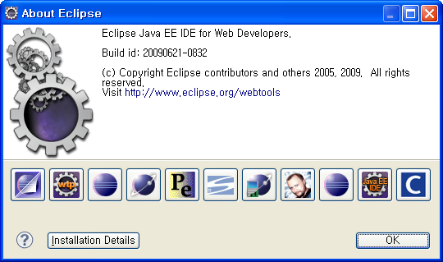
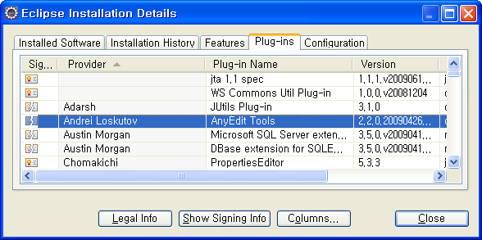
Subclipse
Software Updates
About Eclipse Window
  Install Details
Eclipse Installation Details Window
  Plug-ins

